Slide 1
Hospital Database Management System:
Project Implementation
IST 659: M003
Ryan Ondocin & Jimit Mistry

Slide 2

Current Scenario
Some Hospitals still rely on file processing systems to execute clinical functions
With a growing number of staff and patients data processing is becoming more crucial than ever for preventing workflow congestion
Need RDBMS to achieve patient info, arrange appointments and account for costs in a secure manner
Must take HIPAA into considerations to remain ethically compliant
Notes:
Our proposed solution is to create a relational database that efficiently, securely and succinctly processes medical information. The system would be able to digitally store patient medical records, appointment schedules, medical staff directories, room assignments and billing information. This approach would be less time consuming and more secure than a file processing system which affords the user a much better experience. Automating the process would also improve healthcare management and staff/patient interactions as greater precision would be conducted in regards to planning. The patient would be able to plan their appointments, view their billing statements and access their medical records on one secure platform ahead of time. The beauty in this approach is that by minimizing logistical congestion in the hospital, you can optimize the time spent being treated and cared for by medical personnel. Our system would also allow doctors to quickly retrieve/update medical notes which can ensure that the best diagnostic practices are being put to use.

Slide 3
Entities
Patient
(inpatient/outpatient)
Doctor
Administration
Rooms
Billing
Diagnosis
Notes:
Our system will be composed of doctors, patients, diagnoses, billing information, inpatient room planning and administrators. Admin will be able to administer billing statements, assign inpatients to rooms based on availability, confirm/modify/delete appointments and edit patient/staff details. Patients will be able to view their diagnosis/billing charges and schedule appointments. Doctors will be able to modify/view patient medical records, update their consultation fees and diagnose patients based on their symptoms. Given HIPAA considerations and the confidential nature of medical information, all users will simply not have equal access to the data. Patients will not have the ability to share their medical records with outside users nor will doctors. These safeguards will protect the management system from data leaks/breaches and ensure that the most ethical practices are utilized.

Slide 4



RDBMS Aspects
Admissions/Room Assignments
Patient Info - bio/medical details
Doctors - appointments
Consult - medications/treatment
Billing - total cost of medical services
Tip
If one example isn’t sufficient to help people understand the breadth of your idea, pick a couple of examples.

Slide 5

Expectations
Automate hospital operations
Improve planning and data access aspects regarding clinical data
Appointments
Treatments
Provide timely access to patient staff info in a secure manner

Slide 6
Admin
Billing/Rooms/
Records
Hospital RDBMS
Bill/treatment
Patient
Medical details
Treatment
Doctor
Patient Records

Slide 7
Functions
Admin
Patient
Edit/View Doctor Details
Edit/View Patient Details
Manage Room Assignments
Make/View Appointment
Confirm Appointment
View Diagnosis
Update Medical info
View Bills
Doctor

Slide 8
Patient View Output
View Patient Diagnosis
Patient Bill
Updated Patient History
View Appointments

Slide 9
Admin Capabilities
Edit Patient/Doctor Details
Manage Room Assignments
Make/View Appointments
Administer Bills

Slide 10
Doctor Capabilities
Update/View Patient Medical Info
Update/View Doctor Details

Slide 11
1. Limitations
Hospital Inventory
Payroll Management
Insurance Claim Processing
Unstructured Data
(X Rays/CT/PET/MRI)
Lab Results
Notes:
That being said, our proposal is not nearly robust enough to account for all of the functions that occur in a fully operational medical unit. A few considerations we have chosen to omit are things such as hospital inventory and payroll management to name a few. Similarly, we will never be able to fully encompass all of the intricacies associated with insurance claim processing or financial assistance programs designed for accommodating certain patients due to their intrinsic complexities. We will, however, create a system that can fundamentally deal with the central processes that are vital for clinical administrations. Additionally, we will avoid dealing with unstructured data such as CT/PET-Scans/X-Rays/MRIs generated from lab results because of their difficulty in obtaining and interpreting on a high-level. In order to omit unstructured data from our relational database we will solely be dealing with medical records/diagnostics in a textual form.

Slide 12
Project Requirements
Windows 7 and up
MySQL Community Server
MS Access

Slide 13

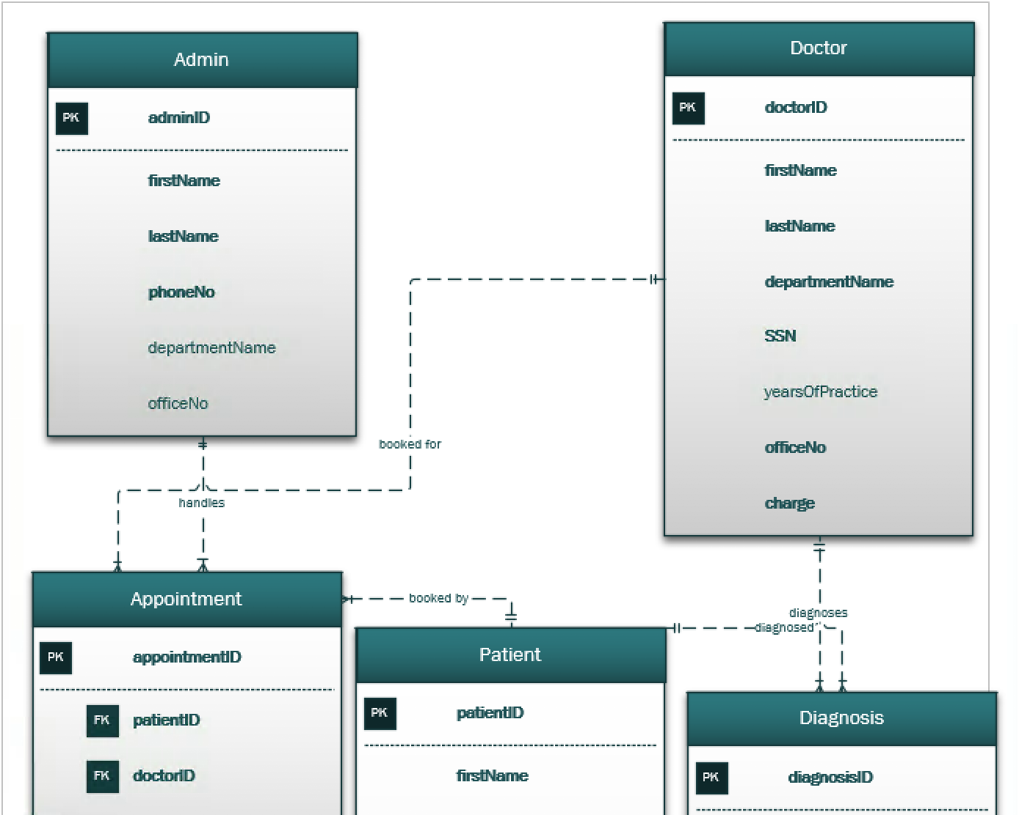
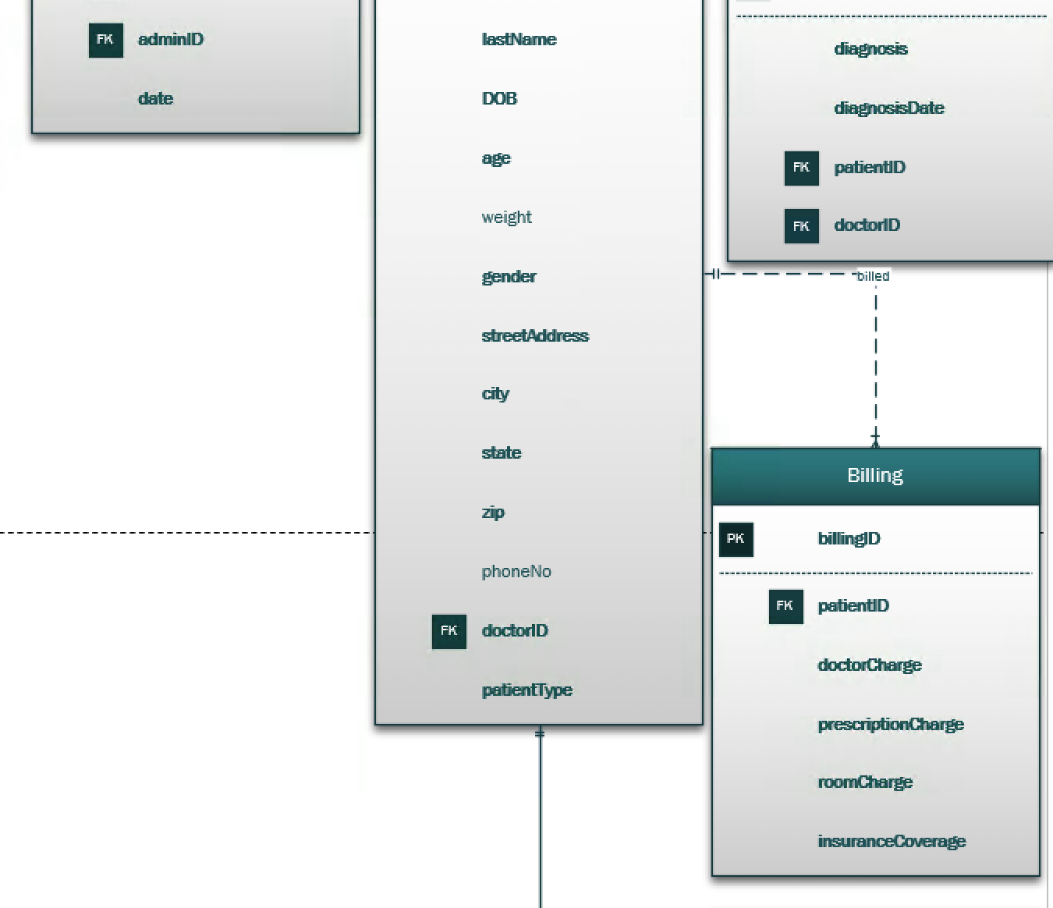
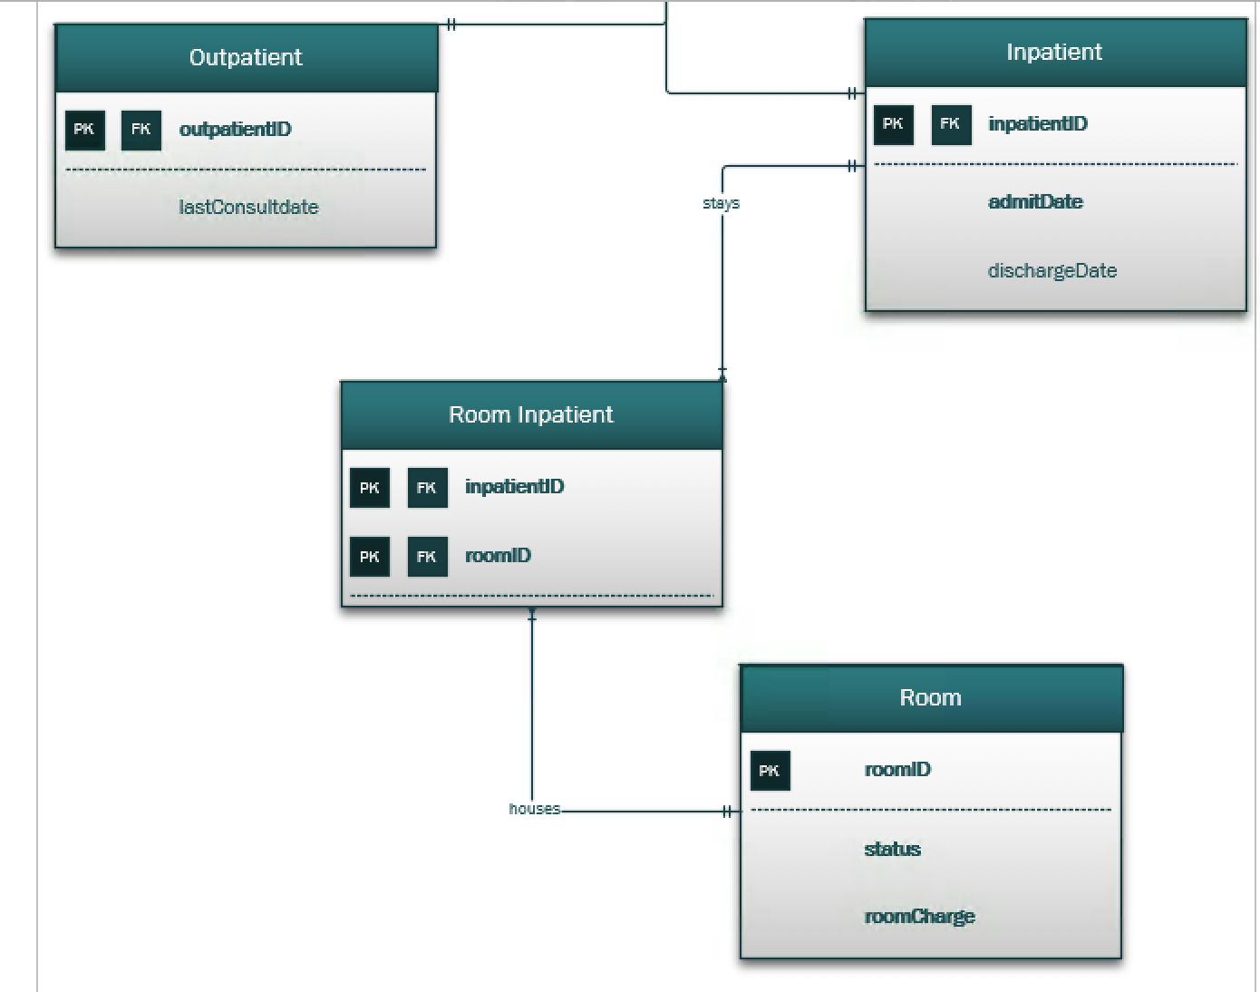
Entity Relationship Diagram Appointment Patient Diagnosis

Slide 14

Major Data Questions:
What is the total cost of a hospital visit for any given patient?: Admin
How many Doctors are in a given department?: Admin
How can administrative assistants ensure that enough rooms are available for all inpatients?: Admin
How can doctors remember and treat patients they haven't seen for a while?: Doctors (Video)
Which doctor is the most experienced based on years of practice?: Admin/Doctors
Which diseases are most common?:Doctor
Which Patient has highest insurance coverage: Admin
Notes:
The data intake process is as follows. There is a medical form that is filled out ahead of time by the patient online. This form would capture the bare-essentials necessary for proper treatment to take place such as patient information and medical history(name, address, height, weight etc. etc..). Admin would be responsible for entering this information into a system that would update if the patient has visited a hospital before and be created if it’s a patient’s first visit. Appointments are scheduled ahead of time, via a phone call by the patient. The administrator will determine when an appointment can take place based on the doctor's availability(offline). After an appointment has occurred the doctor provides a proper diagnosis to the patient and he/she enters this diagnosis into the system effectively updating the patient’s medical records. Following the visit, the service charges will be totaled and issued to the patient one day after they have left the hospital. If the patient has been admitted then room availability is checked by an administrator and the patient is assigned a room. After the patient has been discharged their ‘type’ is changed from inpatient to outpatient by an administrator. The bill is administered the day after a patient has been discharged.

Slide 15
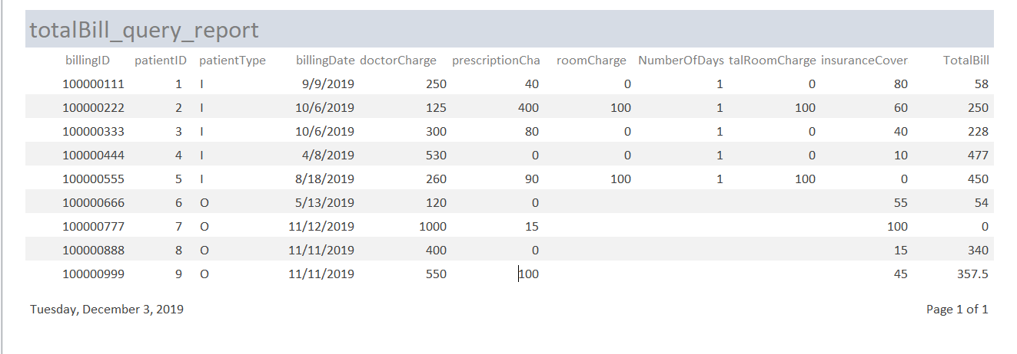
What is the total cost of a hospital visit for any given patient?

Slide 16
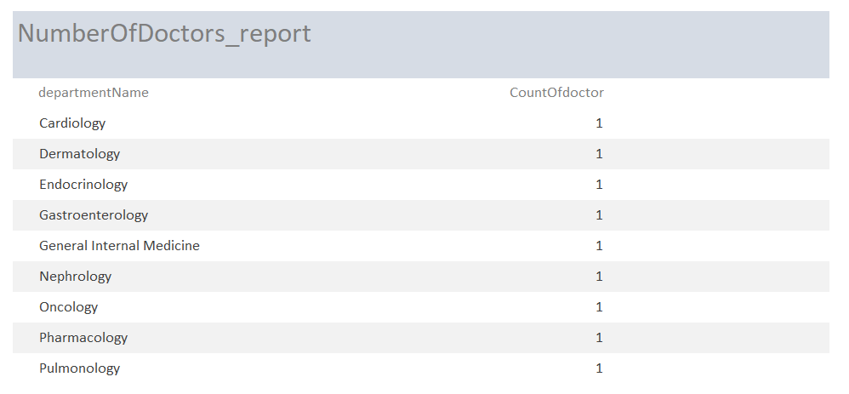
How many Doctors are in a given department?

Slide 17
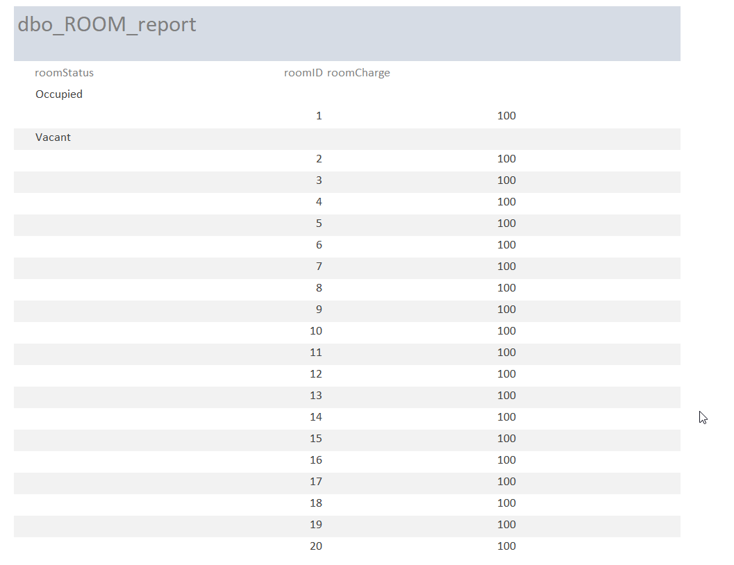
How can administrative assistants ensure that enough rooms are available for all inpatients?

Slide 18
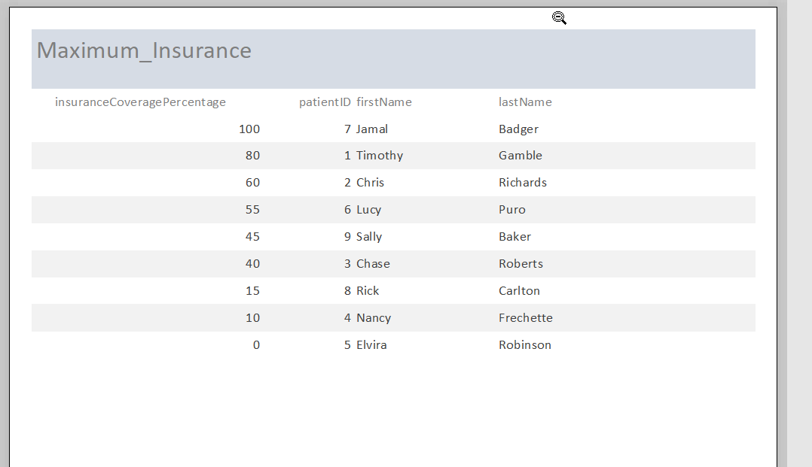
Which patient has the maximum Insurance Coverage(%)?

Slide 19
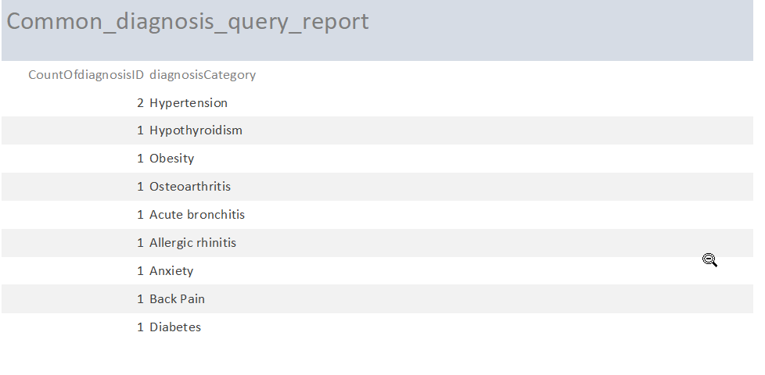
Which diseases are most common?

Slide 20
What is the maximum amount paid by patient?

Slide 21
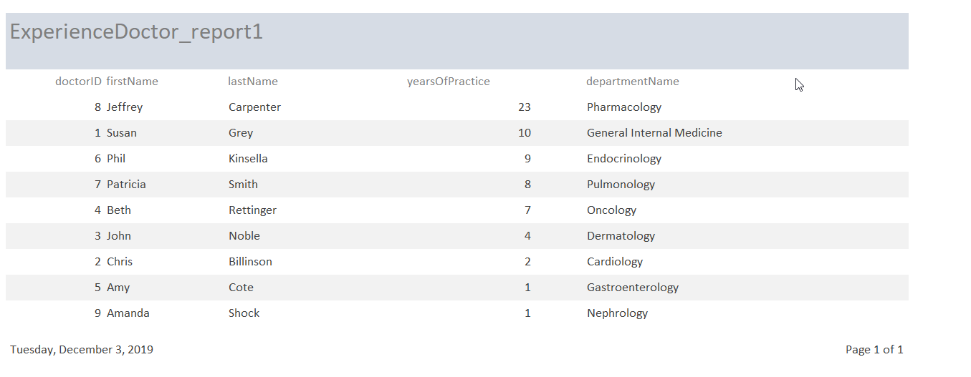
The most experienced doctor:

Slide 22
DEMO SLIDES

Slide 23
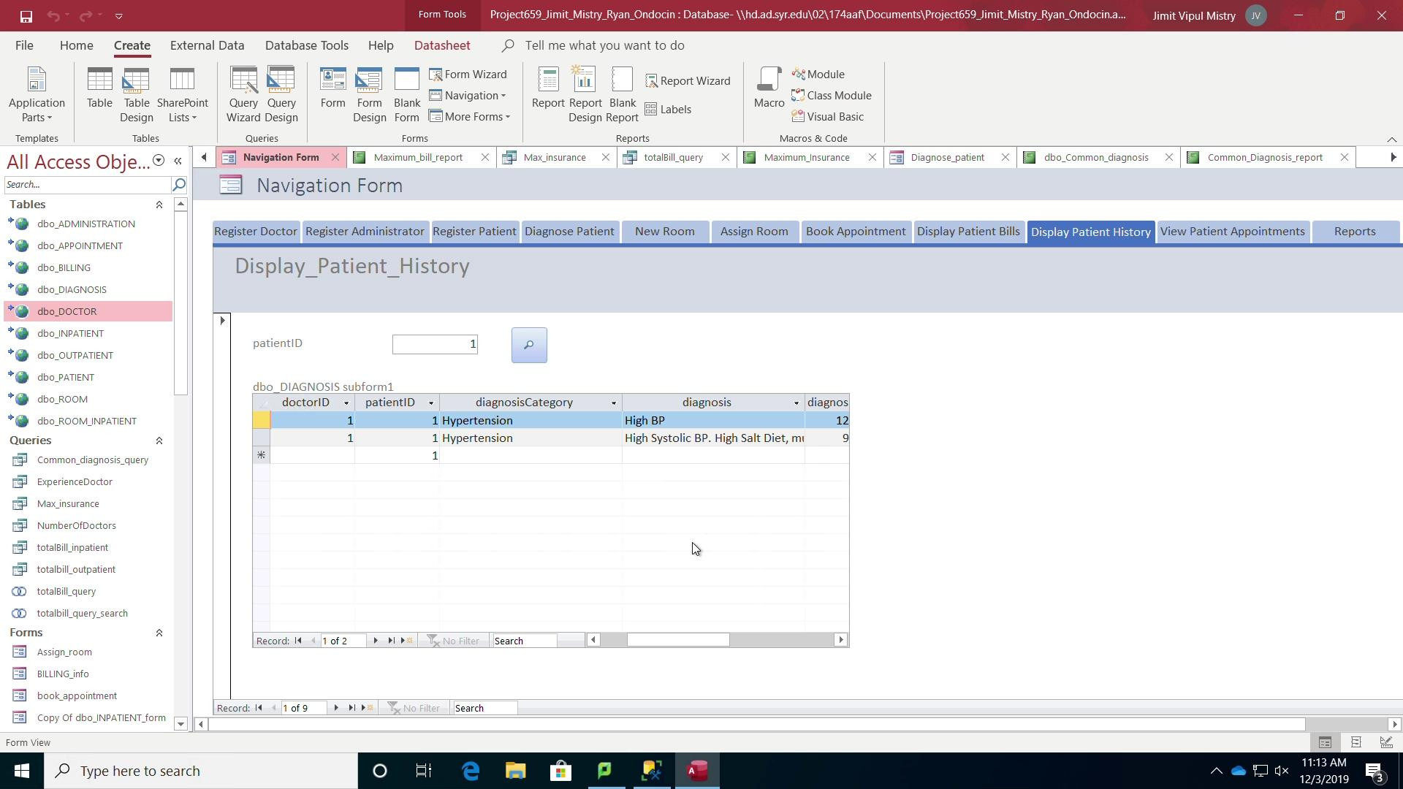

Slide 24
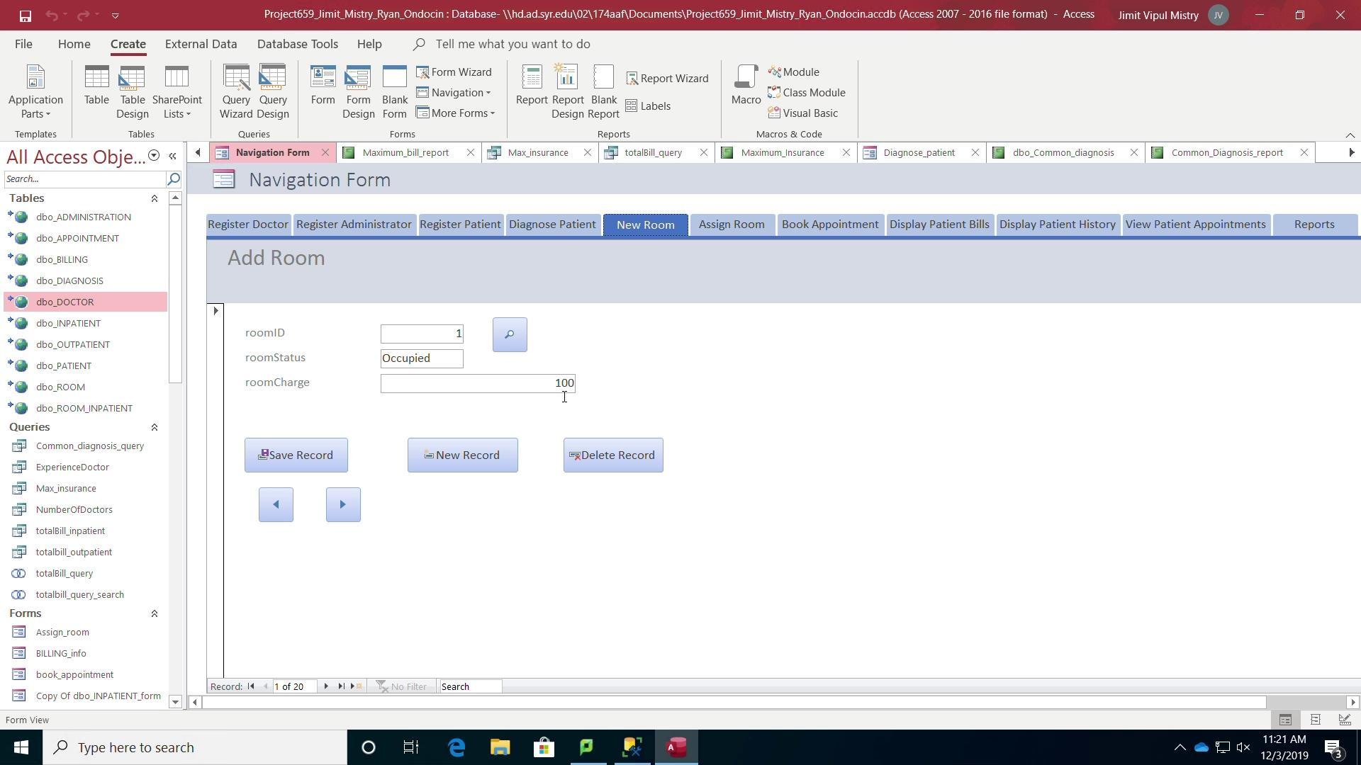

Slide 25
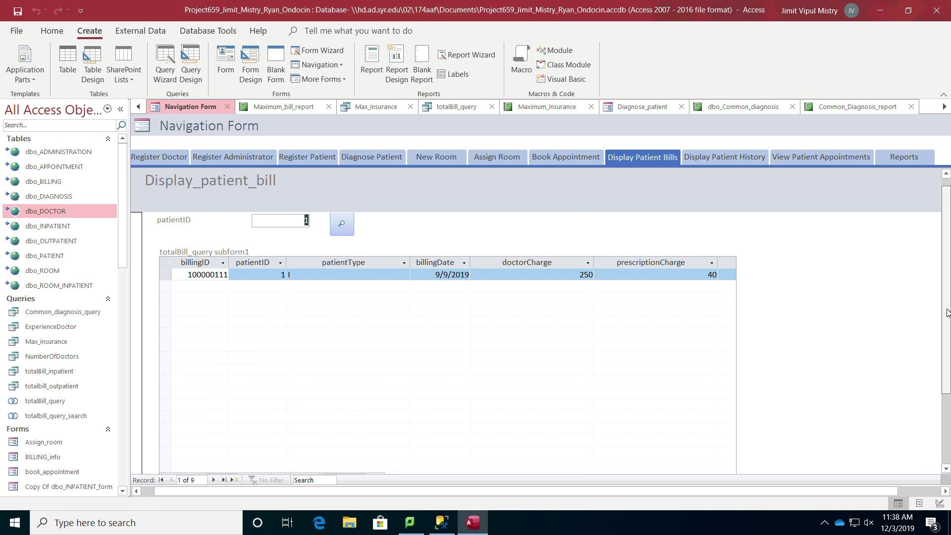

Slide 26
Any Questions?
Thanks

